Slide 1

SUDAKAR MUTHUSAMY
MACHINE LEARNIG
CLASSIFICATION PROJECT ON CUSTOMER CHURN

Slide 2
Customer Churn:
Customer churn, also known as customer attrition, is when a customer stops using a business's products or services for any reason. It's a significant concern for businesses in many industries, including e-commerce, software, telecommunications, and subscription-based services. Churn can impact a company's profitability and growth, and can even damage its reputation.

Slide 3
TABLE OF CONTENT:
Import Libraries
Set options
Read Data
Prepare and Analyse the Data
Classification
Linear Regression
Linear Regression(SGD)
Decision Tree
Decision Tree(Prune)
Decision Tree(Grid Search CV)
Support Vector Machine(Linear)
Support Vector Machine(Gaussian)
Support Vector Machine(Sigmoid)
Support Vector Machine(Poly)
Support Vector Machine(Poly with Degree)
KNN
KNN(Grid)
Random Forest
Bagging Meta Estimator
Ada Boost
XGBM
Conclusion and Interpretation

Slide 4
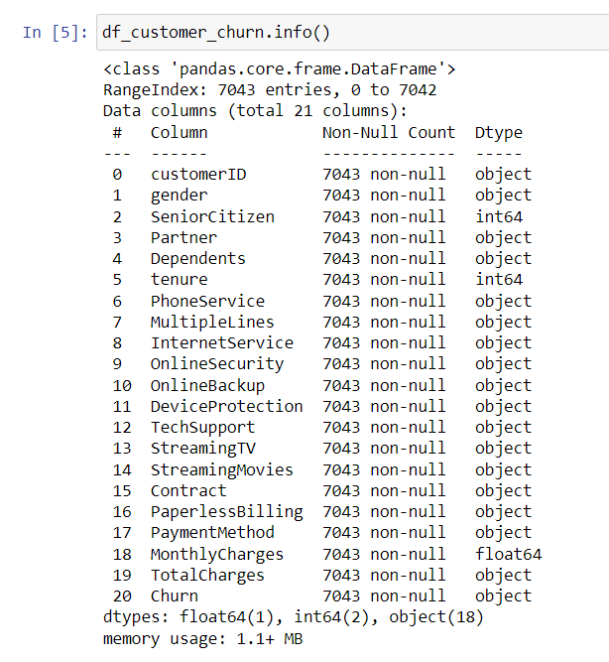
INFO() – Gives information about Range of index, any missing values and it dtypes.

Slide 5
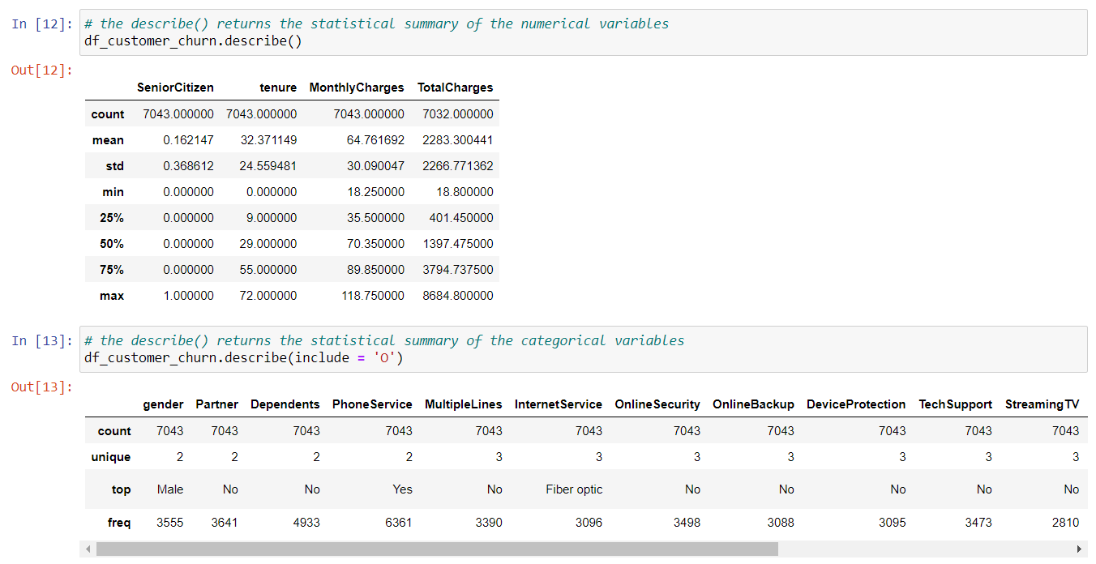
Statistical Summary – We use describe function for numerical values and include = ‘O’ for categorical variables.

Slide 6
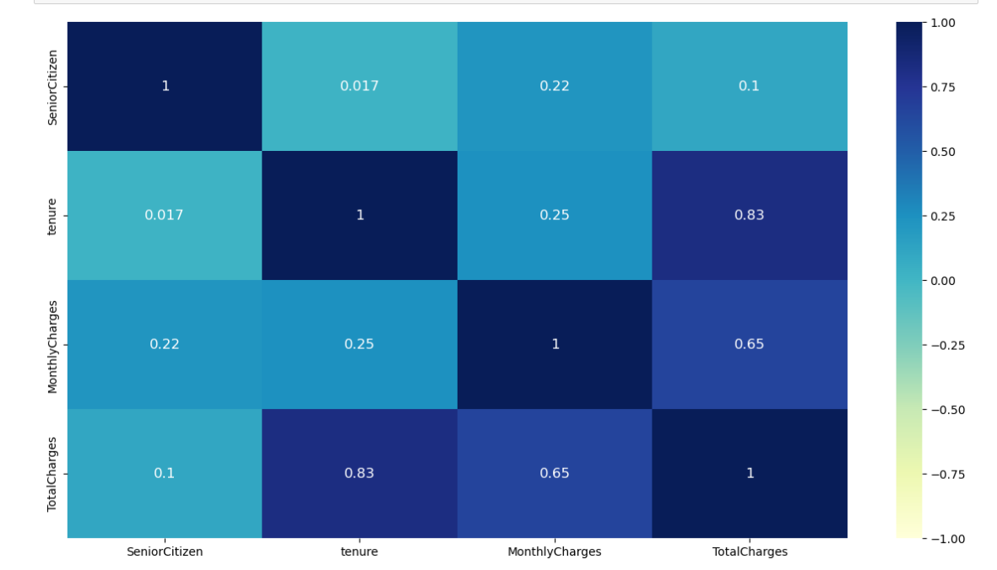
Heatmap – Correlation matrix in order to find any correlation among independent variables

Slide 7
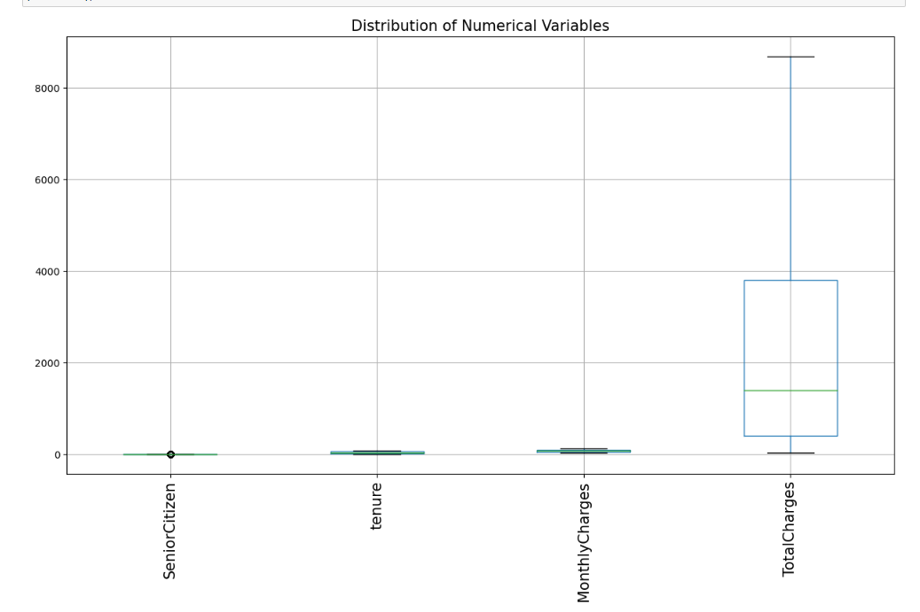
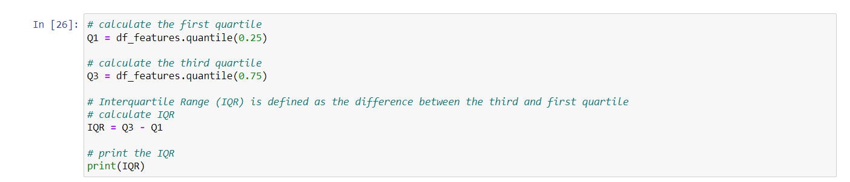
Box Plot – Helps us in understanding outlier of the numerical variables, IQR helps us to find the outliers

Slide 8
Performance Matric:
Confusion Matrix | Hyperparameter Tuning
Accuracy Score | Max Depth
Precision Score | Min Sample Split
Recall Score | Min Sample Leaf
Kappa Score | Max Feature
F1- Score | Criterion
Roc Curve | n Estimator

Slide 9
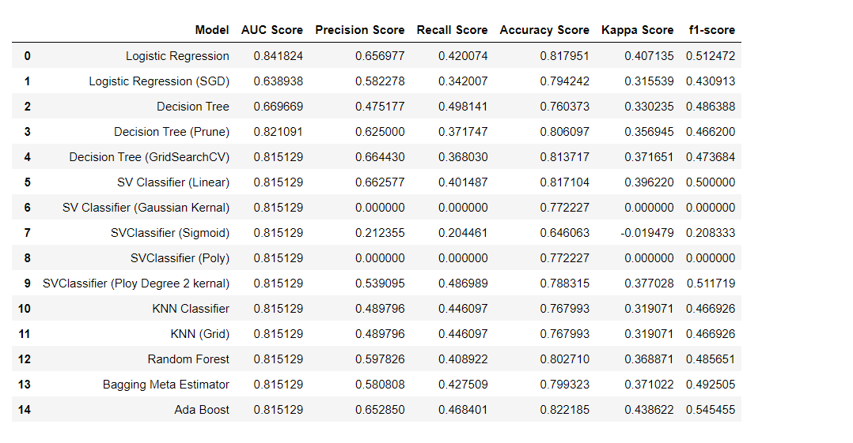
Models Prediction:
The supervised classification learning algorithms have been implemented on the given dataset. The performance of the models were evaluated using AUC score, accuracy, precision, f1-score, recall, and kappa score. The classification model after predicted using various features we can see that accuracy score is almost same for all models except decision tree and there is some variation in AUC score, precision, recall, kappa and f1-score We can say that Ada Boost, XGBM, Random Forest have the high accuracy score, Kappa Score, F1 Score.

Slide 10
Thank You for this Wonderful opportunity.!

